Slide 1

Sorting
Note: Please turn off your microphone and camera.
Mr. Gao's Algorithm
Competition Training Camp

Slide 2
What is sorting?
The most basic definition: to arrange numbers in an array in ascending order.
Input:
An array where all elements are numbers.
Output
The array re-arranged in ascending order
example:
1 3 8 4 6 7 5 2 9 0
0 1 2 3 4 5 6 7 8 9

Slide 3
Common sorting algorithms
Comparison-based sorting algorithms
Select Sort
Bubble Sort
Quick sort
Merge Sort
Special sorting algorithms
Bucket Sort

Slide 4

Select Sort
1 3 8 4 6 7 5 2 9 0
0 3 8 4 6 7 5 2 9 1
0 1 8 4 6 7 5 2 9 3
0 1 2 4 6 7 5 8 9 3
0 1 2 3 6 7 5 8 9 4
0 1 2 3 4 7 5 8 9 6
0 1 2 3 4 5 7 8 9 6
0 1 2 3 4 5 6 8 9 7
0 1 2 3 4 5 6 7 9 8
0 1 2 3 4 5 6 7 8 9
Algorithm principle:
Each pass, determine the smallest number.
After $n$passes, entire array is sorted.
Complexity:
$O(n^{2})$

Slide 5
Select Sort
Code:
for (int i = 0; i < n; ++i) {
int k = i;
for (int j = i+1; j < n; ++j)
if (a[j]<a[k])
k = j;
if (k != i) swap(a[i],a[k]);
}

Slide 6
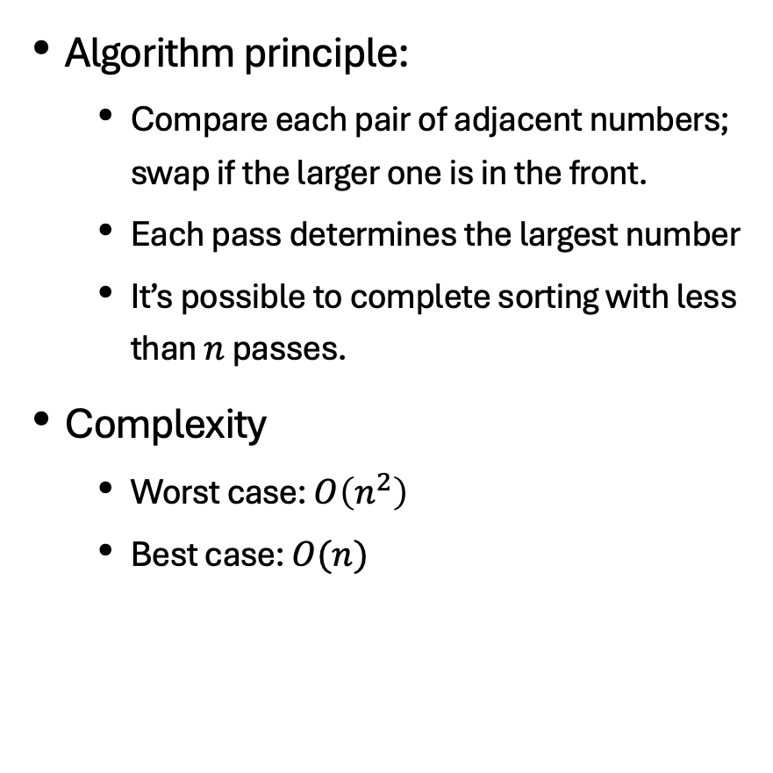
Bubble Sort
Algorithm principle:
Compare each pair of adjacent numbers; swap if the larger one is in the front.
Each pass determines the largest number
It’s possible to complete sorting with less than $n$ passes.
Complexity
Worst case: $O\left(n^{2}\right)$
Best case: $O(n)$
1 3 8 4 0 7 5 2 9 6
1 3 4 0 7 5 2 8 6 9
1 3 0 4 5 2 7 6 8 9
1 0 3 4 2 5 6 7 8 9
0 1 3 2 4 5 6 7 8 9
0 1 2 3 4 5 6 7 8 9
0 1 2 3 4 5 6 7 8 9

Slide 7
Bubble Sort
Code:
for (int i = n-1; i >= 1; -- i) {
bool flag = true;
for (int j = 0; j < i; ++j)
if (a[j] > a[j+1]) {
swap(a[j],a[j+1]);
flag = false;
}
if (flag) break;
}

Slide 8
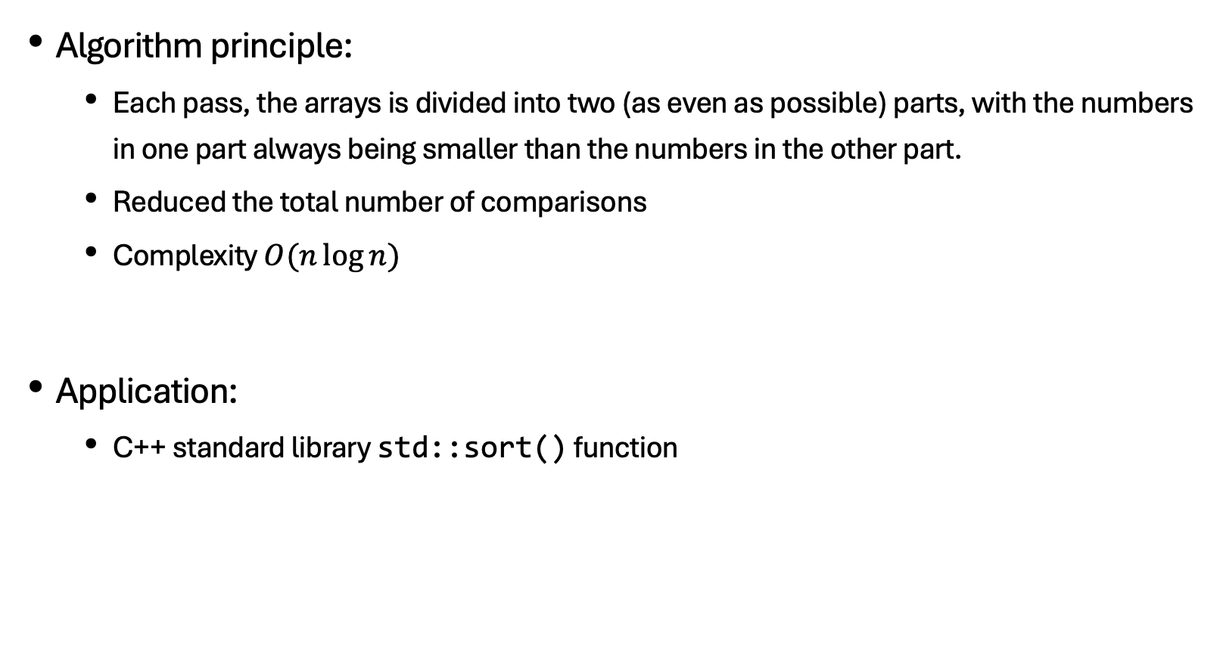
Quick sort
Algorithm principle:
Each pass, the arrays is divided into two (as even as possible) parts, with the numbers in one part always being smaller than the numbers in the other part.
Reduced the total number of comparisons
Complexity $O(n\log{n})$
Application:
C++ standard library std::sort() function

Slide 9
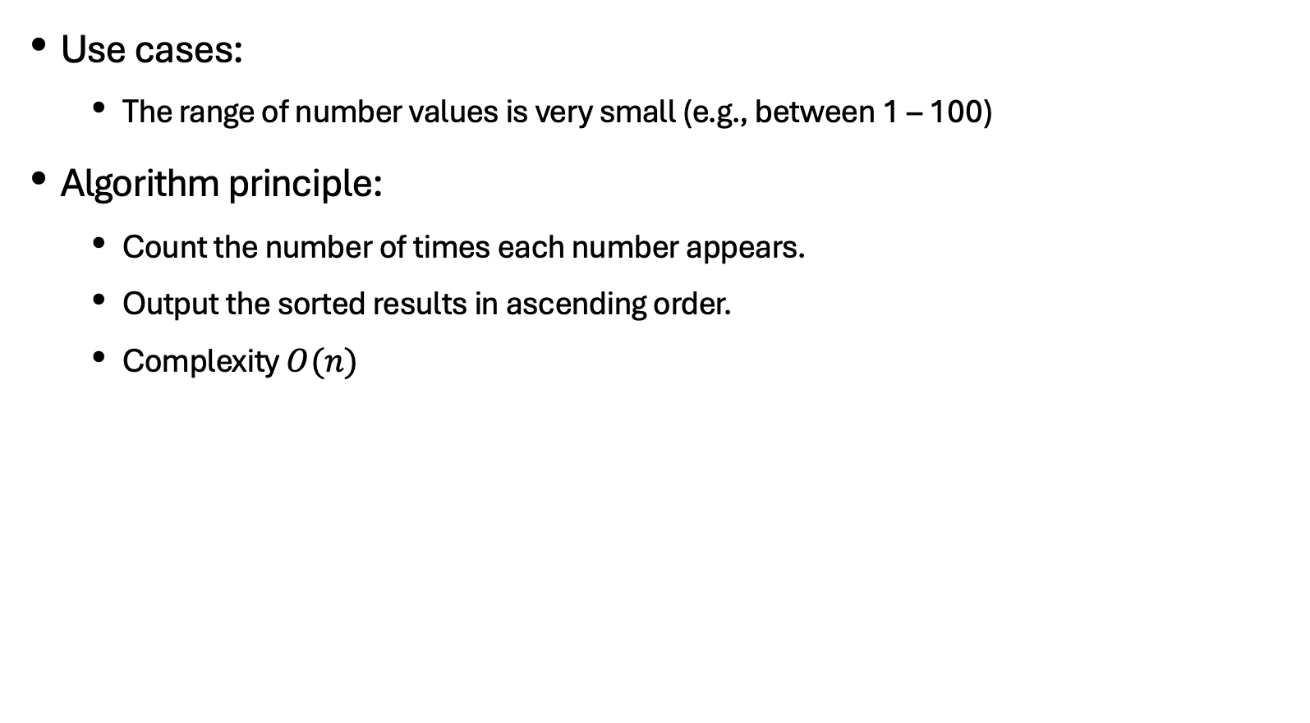
Bucket Sort
Use cases:
The range of number values is very small (e.g., between 1 – 100)
Algorithm principle:
Count the number of times each number appears.
Output the sorted results in ascending order.
Complexity $O(n)$
1 3 8 4 3 5 5 2 9 6 5 2
0 1 2 3 4 5 6 7 8 9
0 1 2 2 1 3 1 0 1 1
1 2 2 3 3 4 5 5 5 6 8 9

Slide 10
Stability of sorting algorithms
What is the stability of sorting algorithms?
A stable sorting algorithm is one that, for any given array, maintains the same order for two equal numbers in the original array after the sorting process.
Are these algorithms stable?
Selection sort: unstable
Bubble sort: stable
Quick sort: unstable
Bucket sort: stable

Slide 11
Concept of ‘order’ in sorting algorithms
Order:
A relationship that describes which element should come before which element (can be understood as a serial number).
Sorting:
An algorithm that arranges array elements according to predefined ‘order’.
example:
Reverse sorting
Integer parity sorting: odd numbers first, even numbers last; odd numbers are sorted from largest to smallest; even numbers are sorted from smallest to largest.

Slide 12
most common sorting method in competitions
std::sort() function in STL is the most common sorting used
sort() function implements an optimised quicksort.
Use it directly; no need to write a quicksort algorithm by hand, avoiding many implementation details.
Just define the “order”, don’t bother the ”sorting” part.
Application:
sort(a, a+n, cmp); or sort(a+1, a+n+1, cmp);
Comparison function cmp() is the key

Slide 13
most common sorting method in competitions
Comparison functions
bool cmp(int a, int b) { }; A return value of ‘true’ indicates that a comes before b
The type of the parameters is determined by the type of the array to be sorted.
bool cmp(const A &a, const A &b) { }; Special syntax when using structs

Slide 14
most common sorting method in competitions
Comparison function examples
Integer parity sorting: odd numbers first, even numbers last; odd numbers are sorted from largest to smallest; even numbers are sorted from smallest to largest.
bool cmp(int a, int b){
if (a%2 == 1 && b%2 == 0) return true;
if (a%2 == 0 && b%2 == 1) return false;
If (a%2 == 1) return a>b;
return a<b;
}

Slide 15
Example question: Patients queuing
Sorting requirements
Senior people are given priority over younger people
Seniors are sorted in descending order of age; if they are the same age, they are sorted listed in the order of checking in.
Younger people (non-seniors) will be sorted in the order of checking in.
Notes:
XMOJ 1240

Slide 16
Example: ming's random number generator
Sorting and deduplication
Notes:
XMOJ 1241

Slide 17
Example: Group photo
Sorting requirements
Boys are on the left, in order of shortest to tallest.
Girls are on the right, in descending order of height.
Notes:
XMOJ 1239

Slide 18
Example: Determining the cutoff score
Sorting requirements
Take the score of the person ranked m * 150% as the cutoff score.
Those who score no lower than the cutoff score will be admitted.
Notes:
XMOJ 1237

Slide 19
Example: Integer parity sorting
Sorting requirements
Odd numbers first, even numbers last
sort odd numbers in descending order
Even numbers sorted in ascending order
Notes:
XMOJ 1238

Slide 20
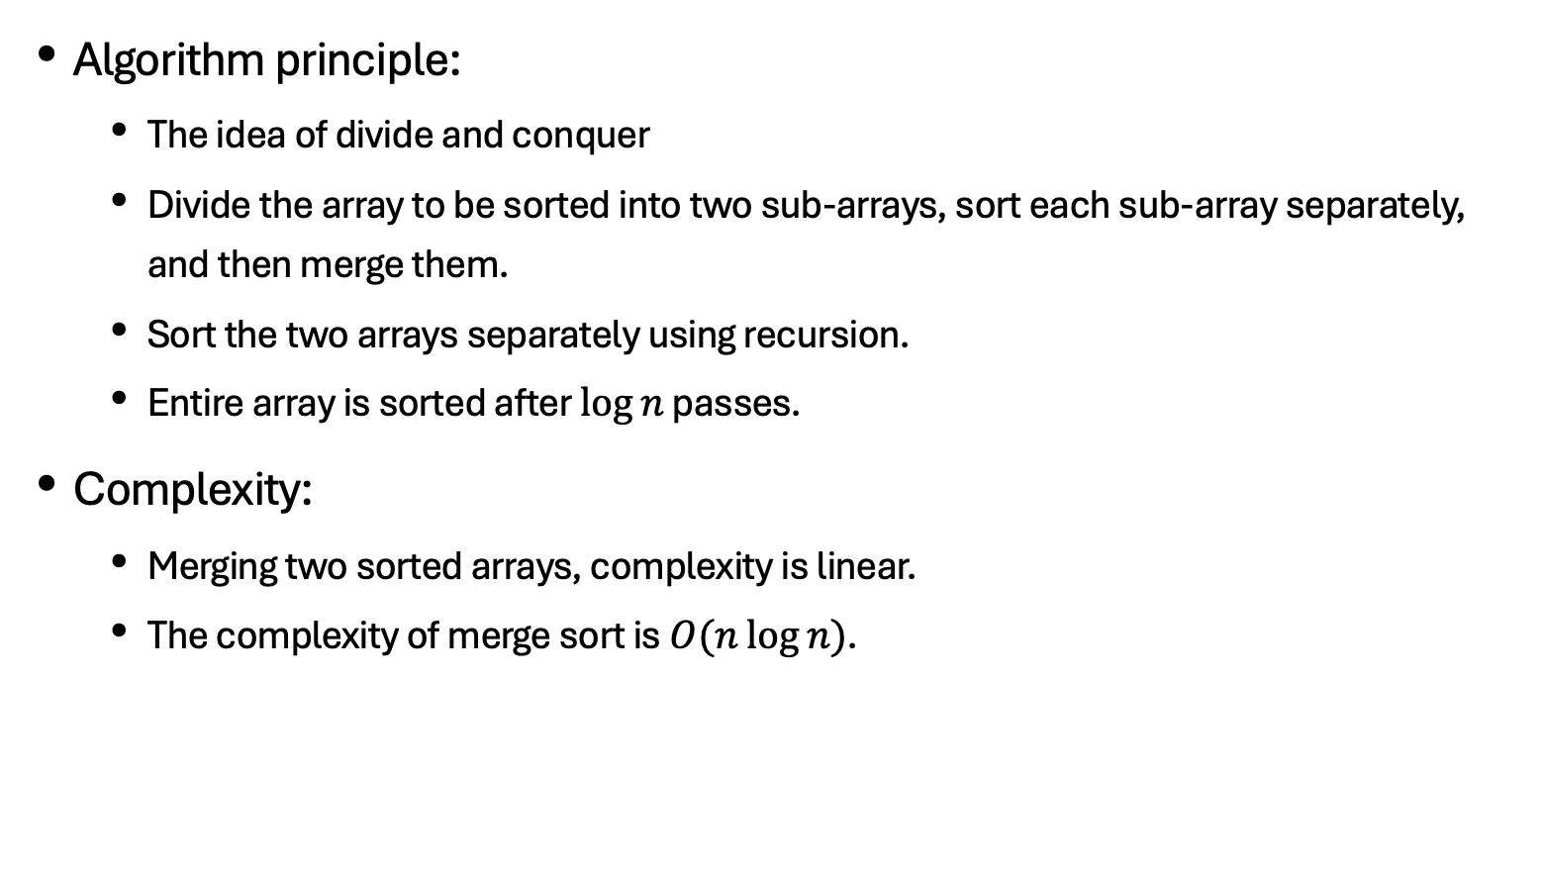
Merge Sort
Algorithm principle:
The idea of divide and conquer
Divide the array to be sorted into two sub-arrays, sort each sub-array separately, and then merge them.
Sort the two arrays separately using recursion.
Entire array is sorted after $\log{n}$ passes.
Complexity:
Merging two sorted arrays, complexity is linear.
The complexity of merge sort is $O(n\log{n})$.

Slide 21
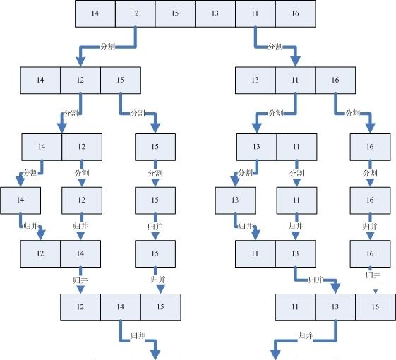
Merge Sort

Slide 22
Merge Sort
Code:
int n, a[N], tmp[N];
void merge_sort(int s, int e){
if (s == e) return;
int mid = (s+e)/2, s1 = s, s2 = mid + 1, t = s;
merge_sort(s, mid); merge_sort(mid + 1, e);
while (s1 <= mid && s2 <= e)
if (a[s1] <= a[s2]) tmp[t++] = a[s1++]; else tmp[t++] = a[s2++];
while (s1 <= mid) tmp[t++] = a[s1++];
while (s2 <= e) tmp[t++] = a[s2++];
for (int i = s; i <= e; ++i) a[i] = tmp[i];
}

Slide 23
Merge Sort
1 3 8 4 6 7 5 2 9 0
1 3 4 6 8 0 2 5 7 9
s mid mid+1 e
s1 s2
0 1 2 3 4 5 6 7 8 9

Slide 24
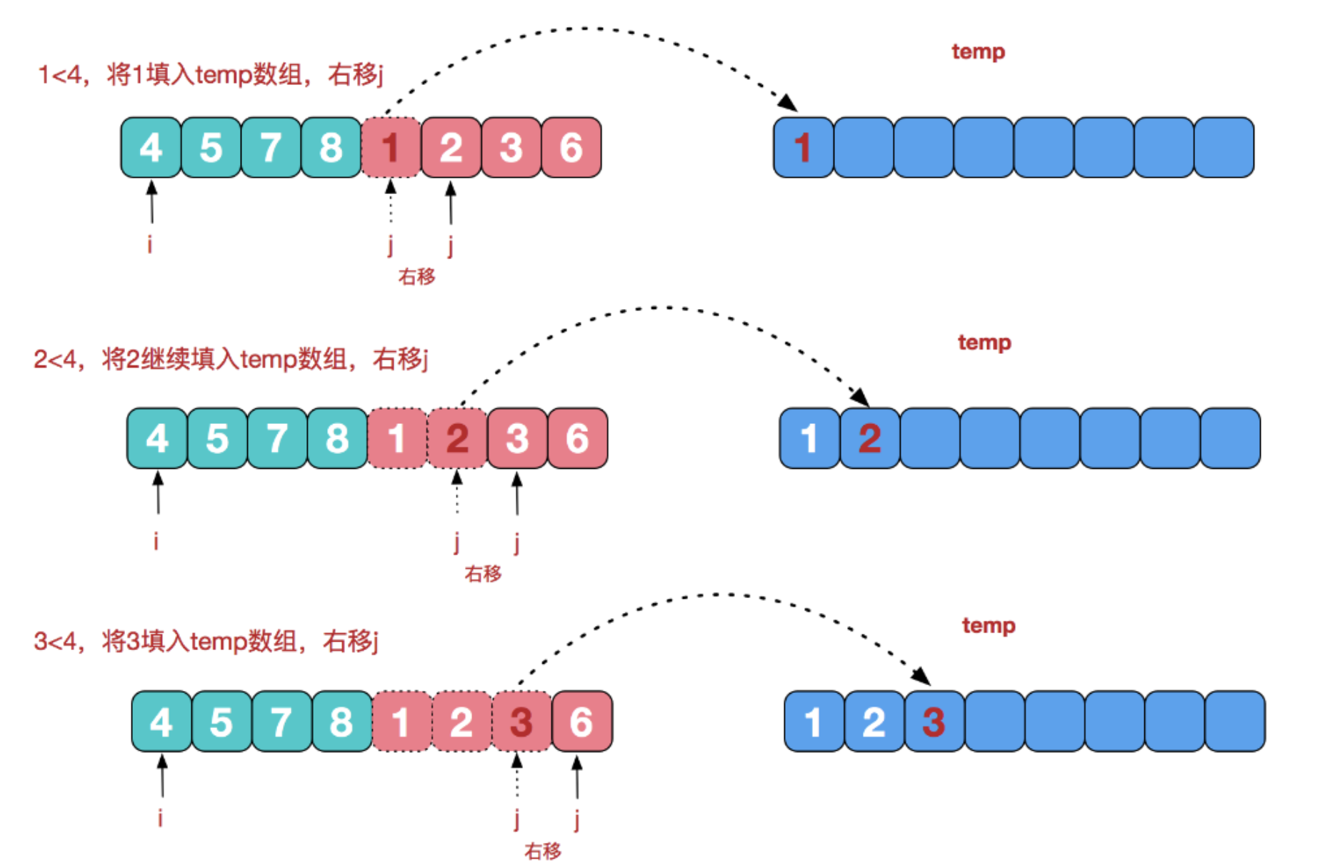
Merge Sort

Slide 25
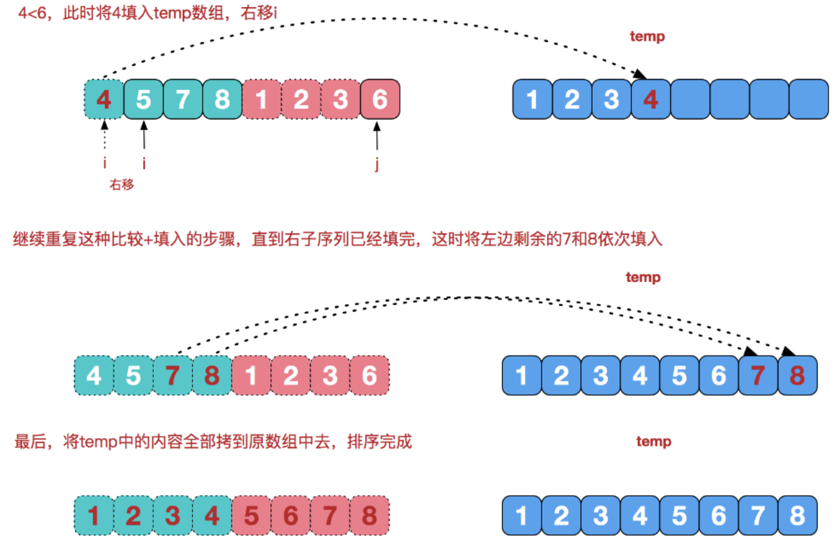
Merge Sort

Slide 26
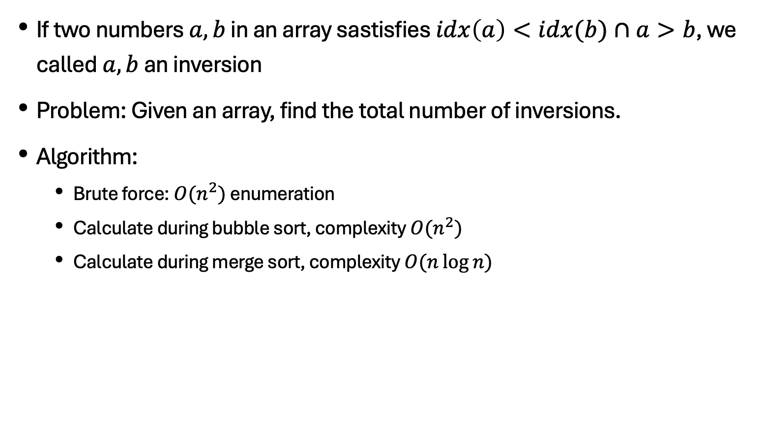
Inversion
If two numbers $a,b$ in an array sastisfies $idx\left(a\right)<idx(b)∩a>b$, we called $a,b$ an inversion
Problem: Given an array, find the total number of inversions.
Algorithm:
Brute force: $O(n^{2})$ enumeration
Calculate during bubble sort, complexity $O(n^{2})$
Calculate during merge sort, complexity $O(n\log{n})$

Slide 27
Merge Sort
1 3 8 4 6 7 5 2 9 0
1 3 4 6 8 0 2 5 7 9
s mid mid+1 e
s1 s2
0 1 2 3 4 5 6 7 8 9

Slide 28
Merge Sort
int n, a[N], tmp[N];
void merge_sort(int s, int e) {
if (s>=e) return;
int mid=(s+e)/2, s1=s, s2=mid+1, t=s;
merge_sort(s,mid); merge_sort(mid+1,e);
while (s1<=mid&&s2<=e)
if (a[s1]<=a[s2]) tmp[t++]=a[s1++];
else ans+=mid-s1+1, tmp[t++]=a[s2++];
while (s1<=mid) tmp[t++]=a[s1++];
while (s2<=e) tmp [t++]=a[s2++];
for (int i = s;i <=e;++ i ) a[ i ]= tmp [ i ];
}

Slide 29
Minimum number of inversions
Given a permutation of 1 to N , each time you can perform the operation of moving the first character to the last character.
Find the smallest among all inversions.

Slide 30
Photograph
Five photos were taken . Before each photo was taken, one person might run around, but each person could only run once at most.
People are numbered 1-N
What was the original order?

Slide 31
Photo - SG
Five photos were taken . Before each photo was taken, several people might have been running around, but each person could only run once at most.
What was the original order?

Slide 32
Thank you everyone.
Note: Please turn off your microphone and camera.
Teacher Gao's Algorithm Competition Training Camp

